Slide 1
Disck Cloning
Using Aronis
Bryian ODONGA VU-BCS-2209-0557-DAY
Youtube tutorial link: https://www.youtube.com/watch?v=qCq7gVHeD0g

Slide 2
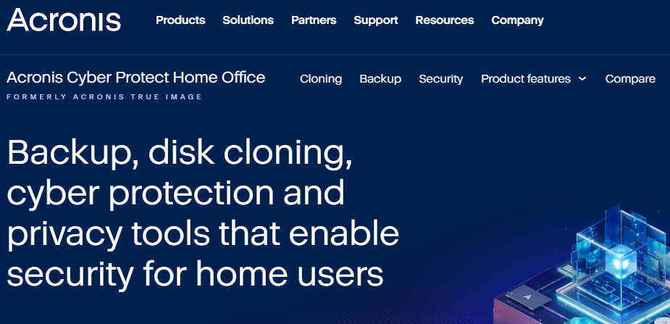
Selected Tool: Acronis True Image

Slide 3
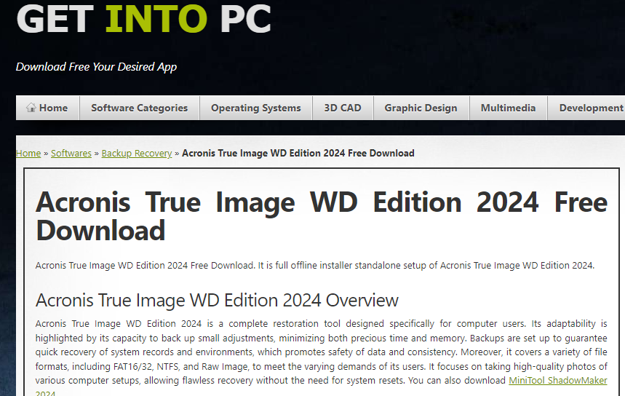
Downloading: From getintopc.com

Slide 4
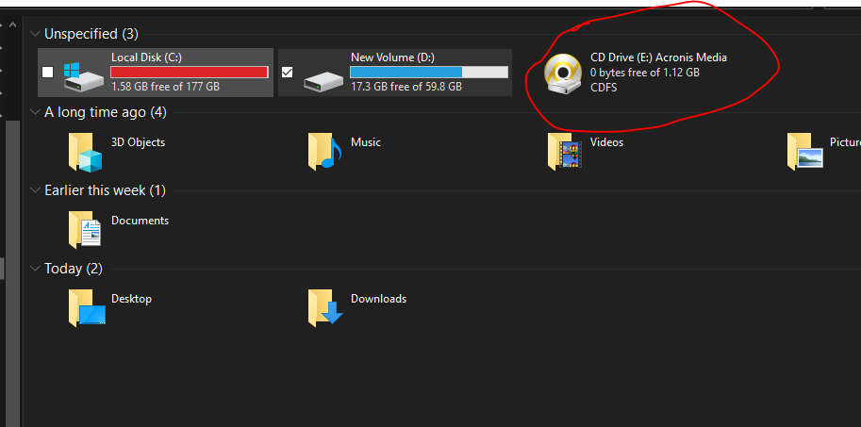
Create bootable media and boot from it

Slide 5
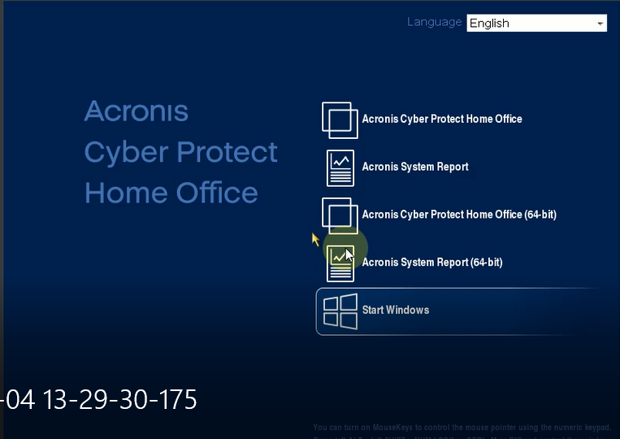
Bootup first screen

Slide 6
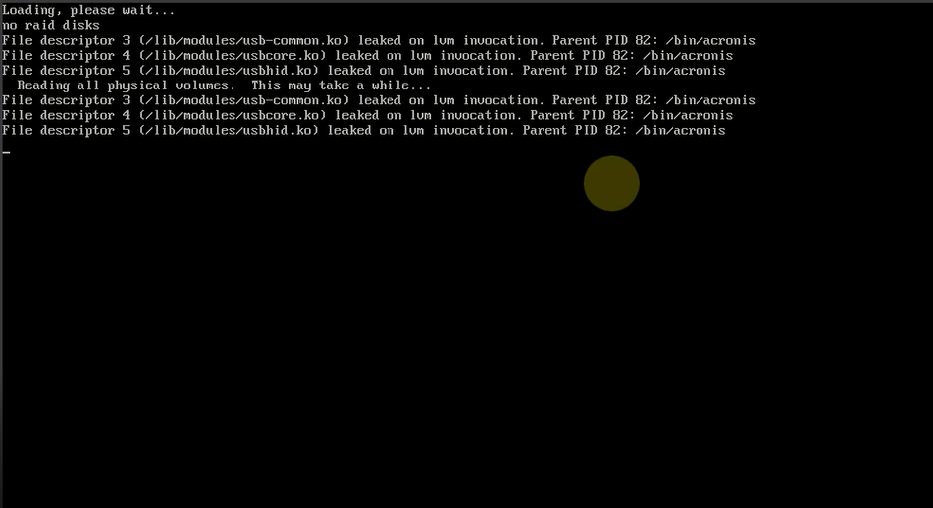
After selecting first option ....

Slide 7
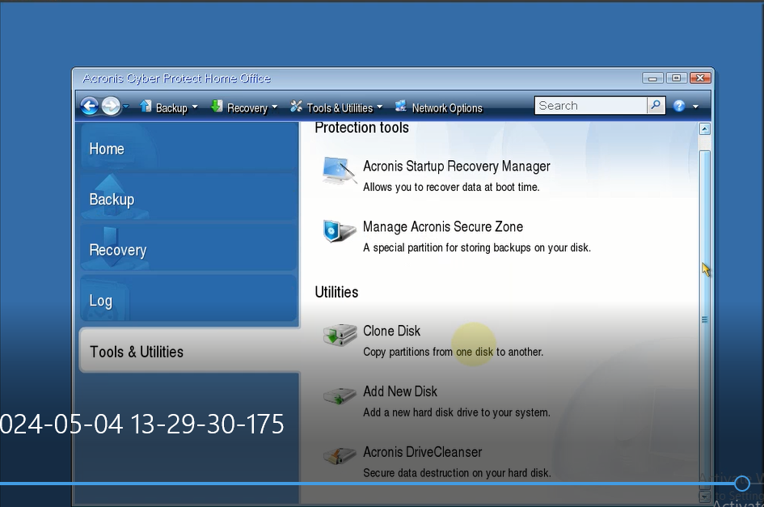
Disk cloning options under utilities

Slide 8
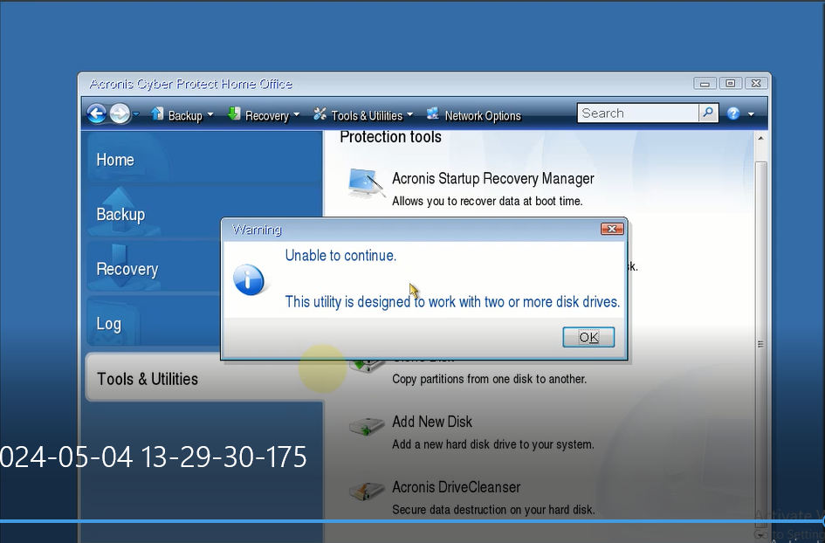
Make sure you insert you have the second disk to be cloned to ..

Slide 9
Conclusion
After follow the instruction and complete the cloning
Ensure the new disk as more enough disk splace to take the “used” disk size of the disk being cloned
You can use the cloned disk to restore your computer to that particular point in time or to create or use it in a new computer with the same make and model

